Slide 1
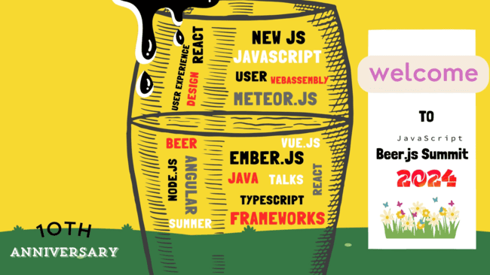

Slide 2


Tsvetozar Cherkezov
introducing
ABOUT MR. BEER.JS
Technical Trainer

Slide 3
Inversion of control with TypeScript
PRESENTATION
A practical demonstration using reflection and dependency injection

Slide 4
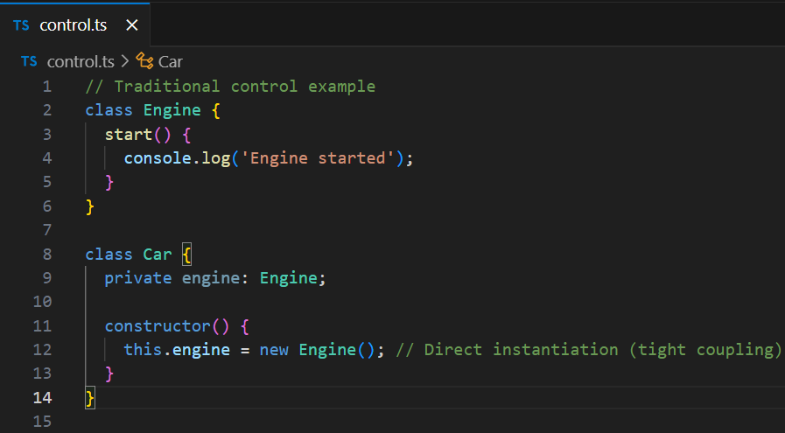
Traditional control
Directly instantiate the dependency in the class
The class itself has control over its dependency

Slide 5
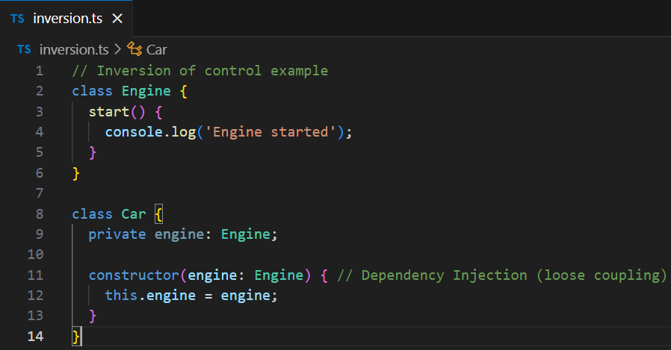
Inversion of control
Invert the control compared to traditional programming
The class doesn’t have control over its dependency

Slide 6
Reflection
Inspect and modify a program during runtime
Reflect API
Built-in JavaScript API
Provides methods for interceptable JS operations
Intercept, manipulate and modify objects
reflect-metadata library
Extends the Reflect API
Adds metadata support
Essential for work with TypeScript decorators

Slide 7
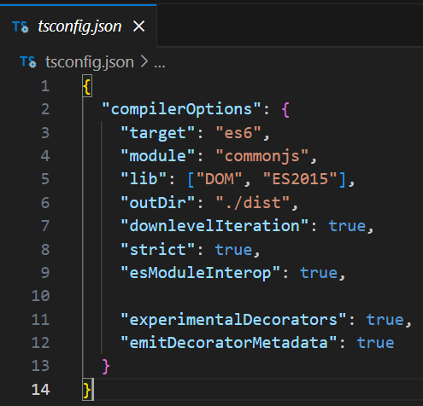
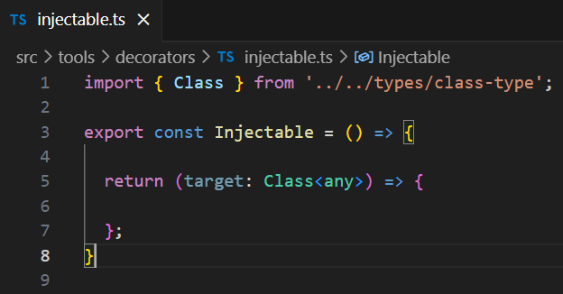
Prerequisites

Slide 8
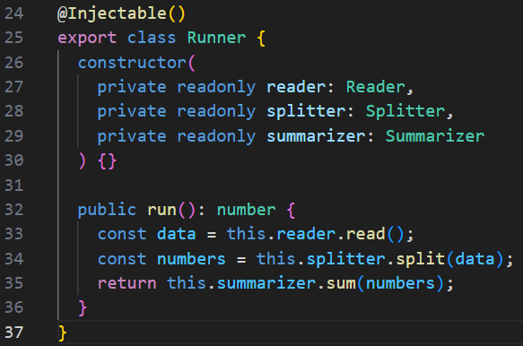
Prerequisites

Slide 9
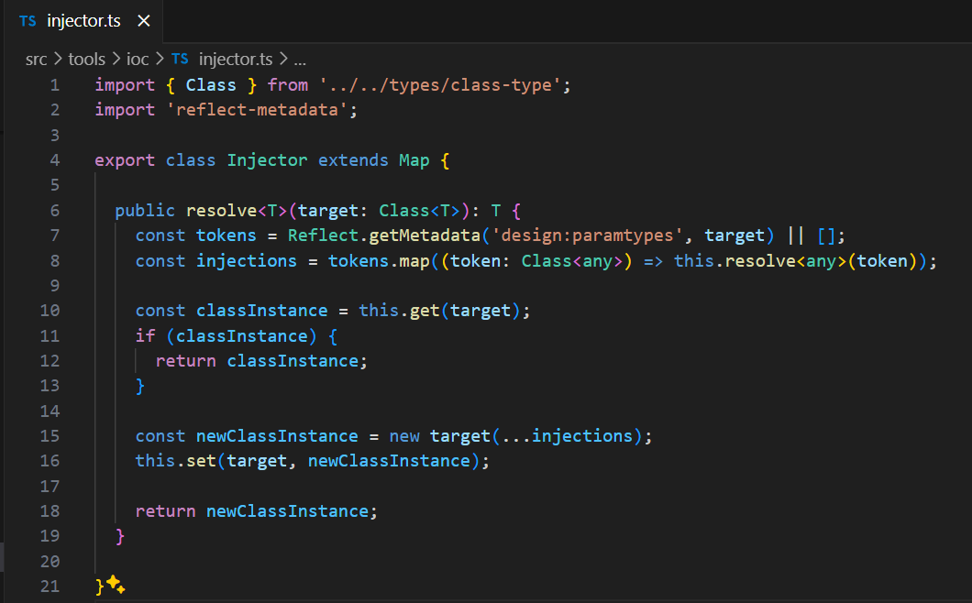
Code Analysis

Slide 10
Why use this approach?
Pros:
Code decoupling
Testability
Flexibility
Maintainability
Readability
Cons:
Complex to learn
Performance overhead
Circular dependencies
Over-engineering

Slide 11

Thank you so much for your attention!
Find the deck and codebase by QR code or link: https://github.com/TelerikAcademy/ioc-demo
I’ll go grab a beer now! Cheers! 🍻

